Slide 1
Les origines de la Préhabilitation
Franco Carli
McGill University - Montreal, Canada

Slide 2
Is preoperative functional capacity modifiable through intervention ? A Theoretical model
reserve
Level of
Functional
Capacity
PREOPERATIVE
SURGERY
RECOVERY
Prehabilitation
Control
Carli F, Zavorsky GS. Curr Opin Clin Nutr Metab Care. 2005;8(1):23-32.
Notes:
Per far fronte al decline funzionale indotto dalla preabilitazione?

Slide 3
Multimodal Transdisciplinary Prehabilitation The McGill Model: Enhancing Reserve
Bousquet-Dion G, Carli F 2018
Notes:
Individual program components individually targeted to increase functional reserve and have a synergistic interaction
The goal is that by increasing reserve, patients will better capacity and tolerate better the physiological stress of surgery

Slide 4
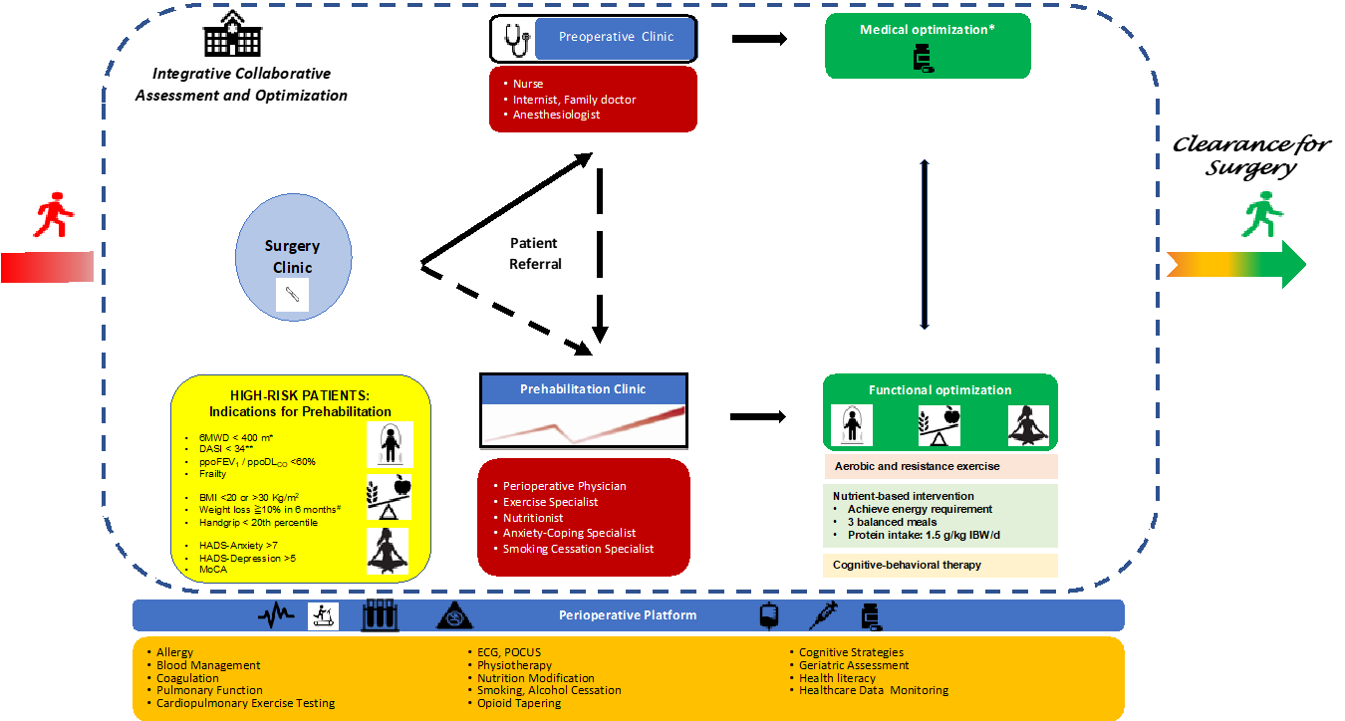
INTEGRATION PREOPERATIVE CLINIC AND PREHABILITATION
Carli F, Baldini G, Feldman L JAMA Surgery, 2020

Slide 5
SCREEN
ASSESS
INTER
VENE
6MWD < 400 m*
DASI < 34
CPET
Timed Up-and-Go test
Sit-to-Stands
Stair climb test
Aerobic exercise
Resistance exercise
Balance, flexibility
Muscle Inspiratory Training
BMI <20 or >30 Kg/m²
Weight loss ≧10% in 6 months#
CNS
Body composition
3-d dietary intake
PG-SGA
Hand-grip strength
Achieve energy requirement
3 balanced meals
Protein intake: 1.5 g/kg IBW/d
Vit D, Omega 3, creatine, immunonutrition
Restlessness and insomnia
Emotional numbness
Apprehension, hypervigilance to symptoms and events
Cognitive re-framing
Promote self-efficacy, personal control & sense of purpose
Teach relaxation skills: deep breathing, guided imagery, mindful meditation, goal setting
Referral
HADS-Anxiety ≧7##
HADS-Depression ≧5
Distress thermometer ≧4
Mini cog
RE-ASSESS
Adapted from
Minnella EM, Carli F. Eur J Surg Oncol. 2018 Jul;44(7):919-926.
Notes:
Figure 1 Proposed clinical pathway for preoperative functional optimzation of patients undergoing colorectal cancer surgery. Adapted from Minnella EM, Carli F. Eur J Surg Oncol. 2018 Jul;44(7):919-926.
6MWD, 6-min walking distance, BMI, body mass index, CPET, Cardiopulmonary exercise testing; HADS, Hospital Anxiety and Depression Scale questionnaire, Anxiety and Depression sub-scale; IBW, ideal body weight, METs, metabolic equivalent; NRS-2002, Nutrition Risk Screening 2002.
*Brunelli A et al, Chest. 2013;143(Suppl):e166S–90S; Minnella EM, et al, Surgery. 2016 Oct;160(4):1070-1079
** Struthers R, et al, Br J Anaesth. 2008 Dec;101(6):774-80
# or ≧ 5% in 3 months;
##Singer s, British Journal of Cancer, 100(6), 908-912. doi:10.1038/sj.bjc.6604952

Slide 6
Frontline Prehabilitation Team
Periop Physician
Psychologist
Surgeon
Exercise Physiologist/
Physio Therapist
Anesthesiologist
Nurse
Internist
Dietitian

