Slide 1
Intérêts des stratégies non médicamenteuses en chirurgie ambulatoire
Aurore MARCOU

Slide 2
Impératifs pour la chirurgie ambulatoire
Récupération rapide des fonctions vitales:
- récupération hémodynamique (déambulation)
- respiratoire (déglutitions)
- cognitive
Patient confortable (douleur, nausées, anxiété)
Validé par le score de Chung

Slide 3
Intérêt d’associer des techniques non pharmacologiques
Diminuer l’anxiété
↓ inconfort physique et psychique
↓ complications liées au stress
Alléger les médicaments
↓ perturbation des fonctions vitales
↓ effets adverses des médicaments
↓ temps d’immobilisation, ↑ la réhabilitation

Slide 4
Différentes stratégies non médicamenteuses
Environnement calme
Information du patient
Présence soignante
Musicothérapie
Dispositifs immersifs: réalité virtuelle, jeux vidéos, applis
Hypnose médicale

Slide 5
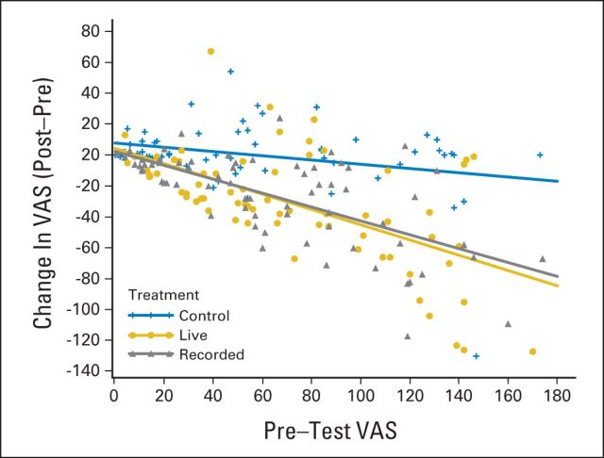
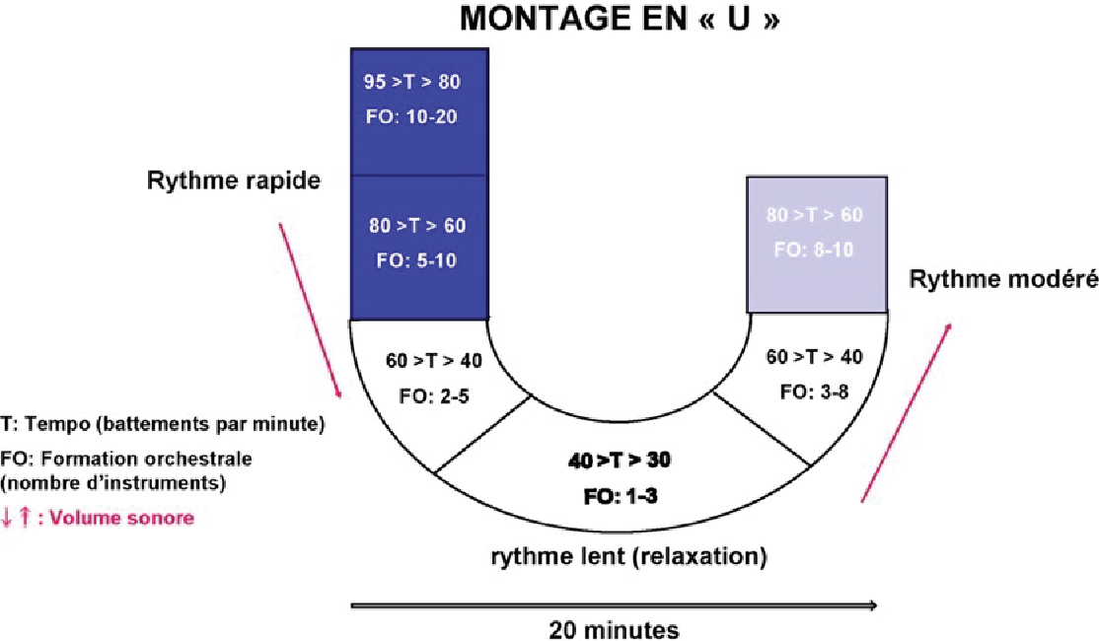
J Bradt et al. Cochrane Database Syst Rev 2013 Jun 6;(6) Music interventions for preoperative anxiety
26 études (2051 patients)
↓ score anxiété p<0,00001 (STAI-S)
JB Palmer et al. JCO 2015
Notes:
Abstract
Background: Patients awaiting surgical procedures often experience significant anxiety. Such anxiety may result in negative physiological manifestations, slower wound healing, increased risk of infection, and may complicate the induction of anaesthesia and impede postoperative recovery. To reduce patient anxiety, sedatives and anti-anxiety drugs are regularly administered before surgery. However, these often have negative side effects and may prolong patient recovery. Therefore, increasing attention is being paid to a variety of non-pharmacological interventions for reduction of preoperative anxiety such as music therapy and music medicine interventions. Interventions are categorized as 'music medicine' when passive listening to pre-recorded music is offered by medical personnel. In contrast, music therapy requires the implementation of a music intervention by a trained music therapist, the presence of a therapeutic process, and the use of personally tailored music experiences. A systematic review was needed to gauge the efficacy of both music therapy and music medicine interventions for reduction of preoperative anxiety.
Objectives: To examine the effects of music interventions with standard care versus standard care alone on preoperative anxiety in surgical patients.
Search methods: We searched the Cochrane Central Register of Controlled Trials (CENTRAL) (The Cochrane Library 2012, Issue 7), MEDLINE (1950 to August 2012), CINAHL (1980 to August 2012), AMED (1985 to April 2011; we no longer had access to AMED after this date), EMBASE (1980 to August 2012), PsycINFO (1967 to August 2012), LILACS (1982 to August 2012), Science Citation Index (1980 to August 2012), the specialist music therapy research database (March 1 2008; database is no longer functional), CAIRSS for Music (to August 2012), Proquest Digital Dissertations (1980 to August 2012), ClinicalTrials.gov (2000 to August 2012), Current Controlled Trials (1998 to August 2012), and the National Research Register (2000 to September 2007). We handsearched music therapy journals and reference lists, and contacted relevant experts to identify unpublished manuscripts. There was no language restriction.
Selection criteria: We included all randomized and quasi-randomized trials that compared music interventions and standard care with standard care alone for reducing preoperative anxiety in surgical patients.
Data collection and analysis: Two review authors independently extracted the data and assessed the risk of bias. We contacted authors to obtain missing data where needed. Where possible, results were presented in meta analyses using mean differences and standardized mean differences. Post-test scores were used. In cases of significant baseline differences, we used change scores.
Main results: We included 26 trials (2051 participants). All studies used listening to pre-recorded music. The results suggested that music listening may have a beneficial effect on preoperative anxiety. Specifically, music listening resulted, on average, in an anxiety reduction that was 5.72 units greater (95% CI -7.27 to -4.17, P < 0.00001) than that in the standard care group as measured by the Stait-Trait Anxiety Inventory (STAI-S), and -0.60 standardized units (95% CI -0.90 to -0.31, P < 0.0001) on other anxiety scales. The results also suggested a small effect on heart rate and diastolic blood pressure, but no support was found for reductions in systolic blood pressure, respiratory rate, and skin temperature. Most trials were assessed to be at high risk of bias because of lack of blinding. Blinding of outcome assessors is often impossible in music therapy and music medicine studies that use subjective outcomes, unless in studies in which the music intervention is compared to another treatment intervention. Because of the high risk of bias, these results need to be interpreted with caution.None of the studies included wound healing, infection rate, time to discharge, or patient satisfaction as outcome variables. One large study found that music listening was more effective than the sedative midazolam in reducing preoperative anxiety and equally effective in reducing physiological responses. No adverse effects were identified.
Authors' conclusions: This systematic review indicates that music listening may have a beneficial effect on preoperative anxiety. These findings are consistent with the findings of three other Cochrane systematic reviews on the use of music interventions for anxiety reduction in medical patients. Therefore, we conclude that music interventions may provide a viable alternative to sedatives and anti-anxiety drugs for reducing preoperative anxiety.

Slide 6
Robin Eijlers et al. Anesth Analg 2019 Nov;129(5):1344-1353. Systematic Review and Meta-analysis of Virtual Reality in Pediatrics: Effects on Pain and Anxiety
17 études: pose VVP, chirurgie dentaire, pansements, soins oncologiques, AG
Mesure anxiété et douleur rapportée par le patient / le soignant
↓ anxiété et douleur rapportées et observées
Notes:
ystematic Review and Meta-analysis of Virtual Reality in Pediatrics: Effects on Pain and Anxiety
Robin Eijlers 1 , Elisabeth M W J Utens 1 2 3 , Lonneke M Staals 4 , Pieter F A de Nijs 1 , Johan M Berghmans 1 5 , René M H Wijnen 6 , Manon H J Hillegers 1 , Bram Dierckx 1 , Jeroen S Legerstee 1
Affiliations
Background: Medical procedures often evoke pain and anxiety in pediatric patients. Virtual reality (VR) is a relatively new intervention that can be used to provide distraction during, or to prepare patients for, medical procedures. This meta-analysis is the first to collate evidence on the effectiveness of VR on reducing pain and anxiety in pediatric patients undergoing medical procedures.
Methods: On April 25, 2018, we searched EMBASE, MEDLINE, CENTRAL, PubMed, Web of Science, and PsycINFO with the keywords "VR," "children," and "adolescents." Studies that applied VR in a somatic setting with participants ≤21 years of age were included. VR was defined as a fully immersive 3-dimensional environment displayed in surround stereoscopic vision on a head-mounted display (HMD). We evaluated pain and anxiety outcomes during medical procedures in VR and standard care conditions.
Results: We identified 2889 citations, of which 17 met our inclusion criteria. VR was applied as distraction (n = 16) during venous access, dental, burn, or oncological care or as exposure (n = 1) before elective surgery under general anesthesia. The effect of VR was mostly studied in patients receiving burn care (n = 6). The overall weighted standardized mean difference (SMD) for VR was 1.30 (95% CI, 0.68-1.91) on patient-reported pain (based on 14 studies) and 1.32 (95% CI, 0.21-2.44) on patient-reported anxiety (based on 7 studies). The effect of VR on pediatric pain was also significant when observed by caregivers (SMD = 2.08; 95% CI, 0.55-3.61) or professionals (SMD = 3.02; 95% CI, 0.79-2.25). For anxiety, limited observer data were available.
Conclusions: VR research in pediatrics has mainly focused on distraction. Large effect sizes indicate that VR is an effective distraction intervention to reduce pain and anxiety in pediatric patients undergoing a wide variety of medical procedures. However, further research on the effect of VR exposure as a preparation tool for medical procedures is needed because of the paucity of research into this field.

Slide 7
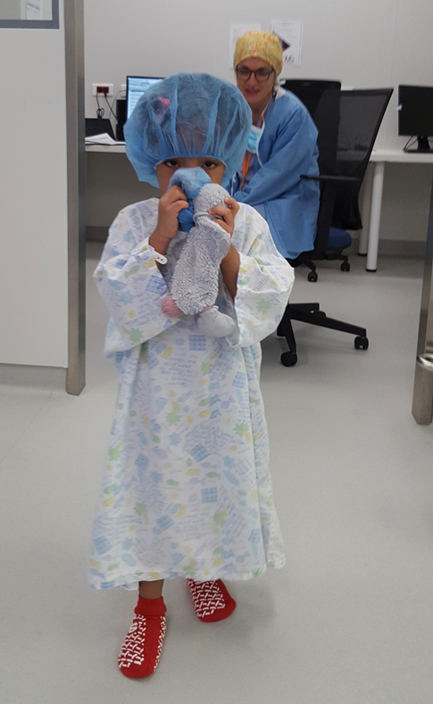
Manyande A et al. Cochrane Database Syst Rev2015 Jul 14;(7). Non-pharmacological interventions for assisting the induction of anaesthesia in children
28 études (2681 enfants)
Peu d’effet
de la présence parentale à l’induction,
la musicothérapie
Effet prometteurs :
parents calmes (acupuncture parentale)
environnement calme,
jeux vidéo, film,
hypnose
Notes:
Background: Induction of general anaesthesia can be distressing for children. Non-pharmacological methods for reducing anxiety and improving co-operation may avoid the adverse effects of preoperative sedation.
Objectives: To assess the effects of non-pharmacological interventions in assisting induction of anaesthesia in children by reducing their anxiety, distress or increasing their co-operation.
Search methods: In this updated review we searched CENTRAL (the Cochrane Library 2012, Issue 12) and searched the following databases from inception to 15 January 2013: MEDLINE, EMBASE, PsycINFO and Web of Science. We reran the search in August 2014. We will deal with the single study found to be of interest when we next update the review.
Selection criteria: We included randomized controlled trials of a non-pharmacological intervention implemented on the day of surgery or anaesthesia.
Data collection and analysis: At least two review authors independently extracted data and assessed risk of bias in trials.
Main results: We included 28 trials (2681 children) investigating 17 interventions of interest; all trials were conducted in high-income countries. Overall we judged the trials to be at high risk of bias. Except for parental acupuncture (graded low), all other GRADE assessments of the primary outcomes of comparisons were very low, indicating a high degree of uncertainty about the overall findings. Parental presence: In five trials (557 children), parental presence at induction of anaesthesia did not reduce child anxiety compared with not having a parent present (standardized mean difference (SMD) 0.03, 95% confidence interval (CI) -0.14 to 0.20). In a further three trials (267 children) where we were unable to pool results, we found no clear differences in child anxiety, whether a parent was present or not. In a single trial, child anxiety showed no significant difference whether one or two parents were present, although parental anxiety was significantly reduced when both parents were present at the induction. Parental presence was significantly less effective than sedative premedication in reducing children's anxiety at induction in three trials with 254 children (we could not pool results). Child interventions (passive): When a video of the child's choice was played during induction, children were significantly less anxious than controls (median difference modified Yale Preoperative Anxiety Scale (mYPAS) 31.2, 95% CI 27.1 to 33.3) in a trial of 91 children. In another trial of 120 children, co-operation at induction did not differ significantly when a video fairytale was played before induction. Children exposed to low sensory stimulation were significantly less anxious than control children on introduction of the anaesthesia mask and more likely to be co-operative during induction in one trial of 70 children. Music therapy did not show a significant effect on children's anxiety in another trial of 51 children. Child interventions (mask introduction): We found no significant differences between a mask exposure intervention and control in a single trial of 103 children for child anxiety (risk ratio (RR) 0.59, 95% CI 0.31 to 1.11) although children did demonstrate significantly better co-operation in the mask exposure group (RR 1.27, 95% CI 1.06 to 1.51). Child interventions (interactive): In a three-arm trial of 168 children, preparation with interactive computer packages (in addition to parental presence) was more effective than verbal preparation, although differences between computer and cartoon preparation were not significant, and neither was cartoon preparation when compared with verbal preparation. Children given video games before induction were significantly less anxious at induction than those in the control group (mYPAS mean difference (MD) -9.80, 95% CI -19.42 to -0.18) and also when compared with children who were sedated with midazolam (mYPAS MD -12.20, 95% CI -21.82 to -2.58) in a trial of 112 children. When compared with parental presence only, clowns or clown doctors significantly lessened children's anxiety in the operating/induction room (mYPAS MD -24.41, 95% CI -38.43 to -10.48; random-effects, I² 75%) in three trials with a total of 133 children. However, we saw no significant differences in child anxiety in the operating room between clowns/clown doctors and sedative premedication (mYPAS MD -9.67, 95% CI -21.14 to 1.80, random-effects, I² 66%; 2 trials of 93 children). In a trial of hypnotherapy versus sedative premedication in 50 children, there were no significant differences in children's anxiety at induction (RR 0.59, 95% CI 0.33 to 1.04). Parental interventions: Children of parents having acupuncture compared with parental sham acupuncture were less anxious during induction (mYPAS MD -17, 95% CI -30.51 to -3.49) and were more co-operative (RR 1.59, 95% CI 1.01 to 2.53) in a single trial of 67 children. Two trials with 191 parents assessed the effects of parental video viewing but did not report any of the review's prespecified primary outcomes.

Slide 8
La technique d’hypnose médicale
Technique individualisée
S’appuie sur la communication thérapeutique
↓ inconfort physique et psychique
↑ coopération du patient ↑ fluidité du soin
Induction d’un mode de concentration hypnotique pour
Changer les perceptions sensorielles et leur interprétation
Notes:
Communication verbale et non verbale
Sortir patient transe négative

Slide 9
Jibba Amraoui et al. JAMA Network Open 2018; 1(4): e181164 Effects of hypnosis session before general anesthesia on postopératoire outcomes in patients who underwent minor breast cancer surgery
298 femmes chirurgie mineure du sein sous AG
Randomisées - hypnose à l’induction (6min) / attention standardisée
↓ médicaments perop (hypnotique et morphinique)
↓ séjour SSPI (46 min vs 60 min)
↓ fatigue et anxiété J0
Notes:
Effets hypnose médiés par diminution détresse émotionnelle préop, attente sur la douleur

Slide 10
Montgomery GH et al. J Natl Cancer Inst 2007; 99(17): 1304-12 A randomized clinical trial of a brief hypnosis intervention to control side effects in breast surgery
200 femmes chirurgie mineure du sein en ambulatoire
sous AL (xylocaïne) + sédation (propofol) à la demande
Randomisées séance d’hypnose préop/ attention standardisée
↓ médicaments
↓ douleur
↓ effets adverses (NVPO, fatigue, inconfort physique et mental)
↓ durée de la procédure, ↓ coût
Notes:
Effets hypnose médiés par diminution détresse émotionnelle préop, attente sur la douleur

Slide 11
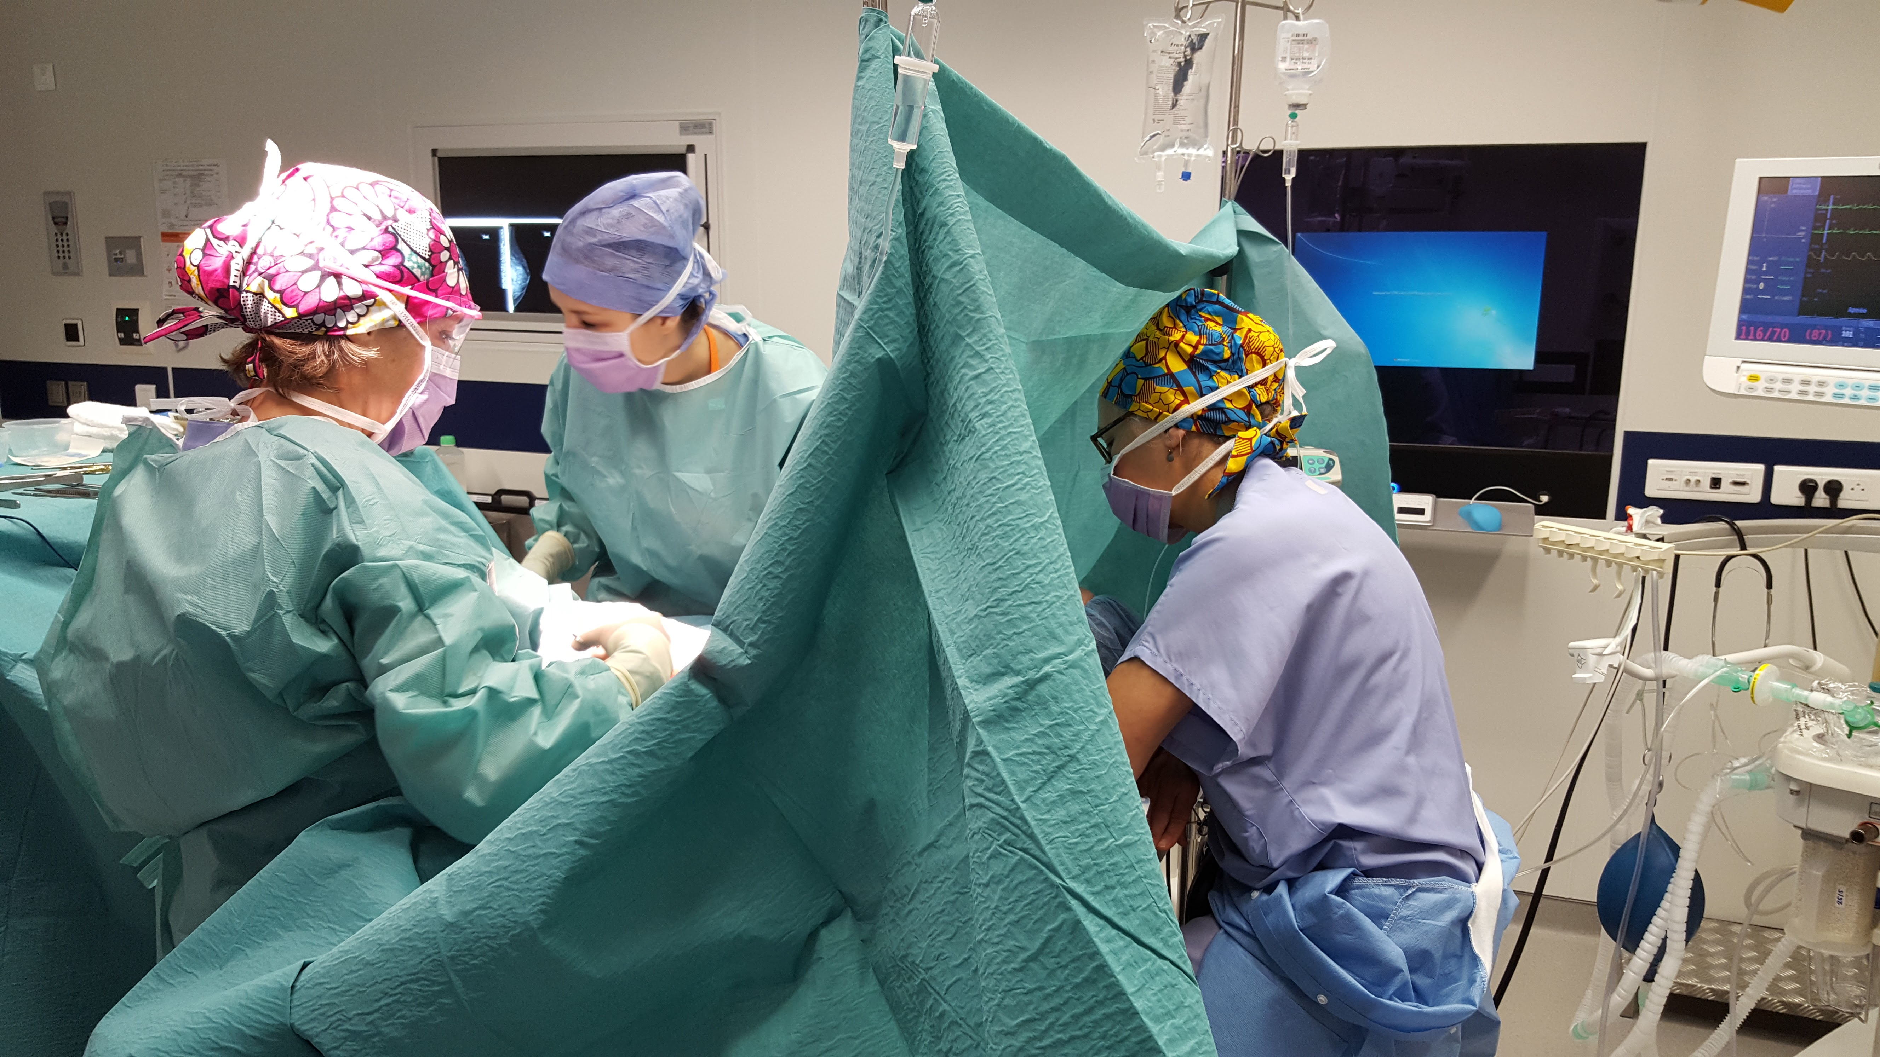
La technique d’hypnosédation
Une technique anesthésique associant
AL / ALR
Analgésie continue intraveineuse
Hypnose
Chirurgie du ORL, sein, gynéco, orthopédique, plastique, dentaire
Conscience
Analgésie
Morphinique
très courte
durée d’action
HYPNOSE
AL ou ALR

Slide 12
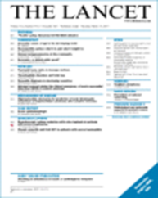
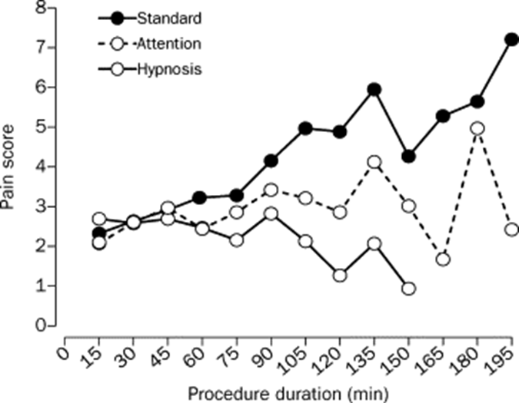
Lang EV, Benotsch EG et al. The Lancet 2000, 355, 9214. 1486-90 Adjunctive non-pharmacological analgesia for invasive medical procedures: a randomized trial.
Radiologie interventionnelle
Sédation midazolam/fentanyl à la demande
241 patients randomisés : Soins courants (S) / attention structurée (E) / Hypnose (H)
↓ Anxiété
↓ douleur H<<S p<0.0001
H<E p=0.00425
↓ consommation médicamenteuse
↓ durée de procédure
↑ stabilité hémodynamique

Slide 13
A Marcou, A Livartowski. Congrès ENCC 2011. Evaluation de la performance de l’hypnosédation en chirurgie ambulatoire
 | AG | Hypnosédation
Echec | 0 % | 0 %
Temps d’occupation du bloc opératoire | 41 min | 39 min
Dépenses matérielles et médicamenteuses | 24E | 19E
Durée de séjour SSPI | 73 min | 36 min
Douleur EVA>3 en SSPI | 12% | 0 %
+ Taux de satisfaction 9.2 /10
100% prêt à une nouvelle intervention sous hypnosédation

Slide 14
A. Marcou et al. Abstract ESA 2018 150 cancer surgeries under hypnosis: a valuable alternative to preserve the ecology of the patients
L’hypnosédation
Une alternative valable à l’anesthésie générale
Minimisant les répercussions d’une chirurgie
Intérêt pour les patients vulnérables et la chirurgie ambulatoire

Slide 15
